Slide 1



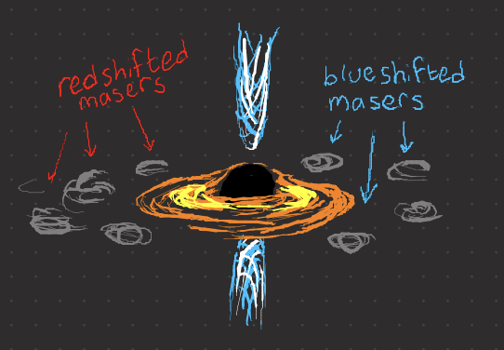
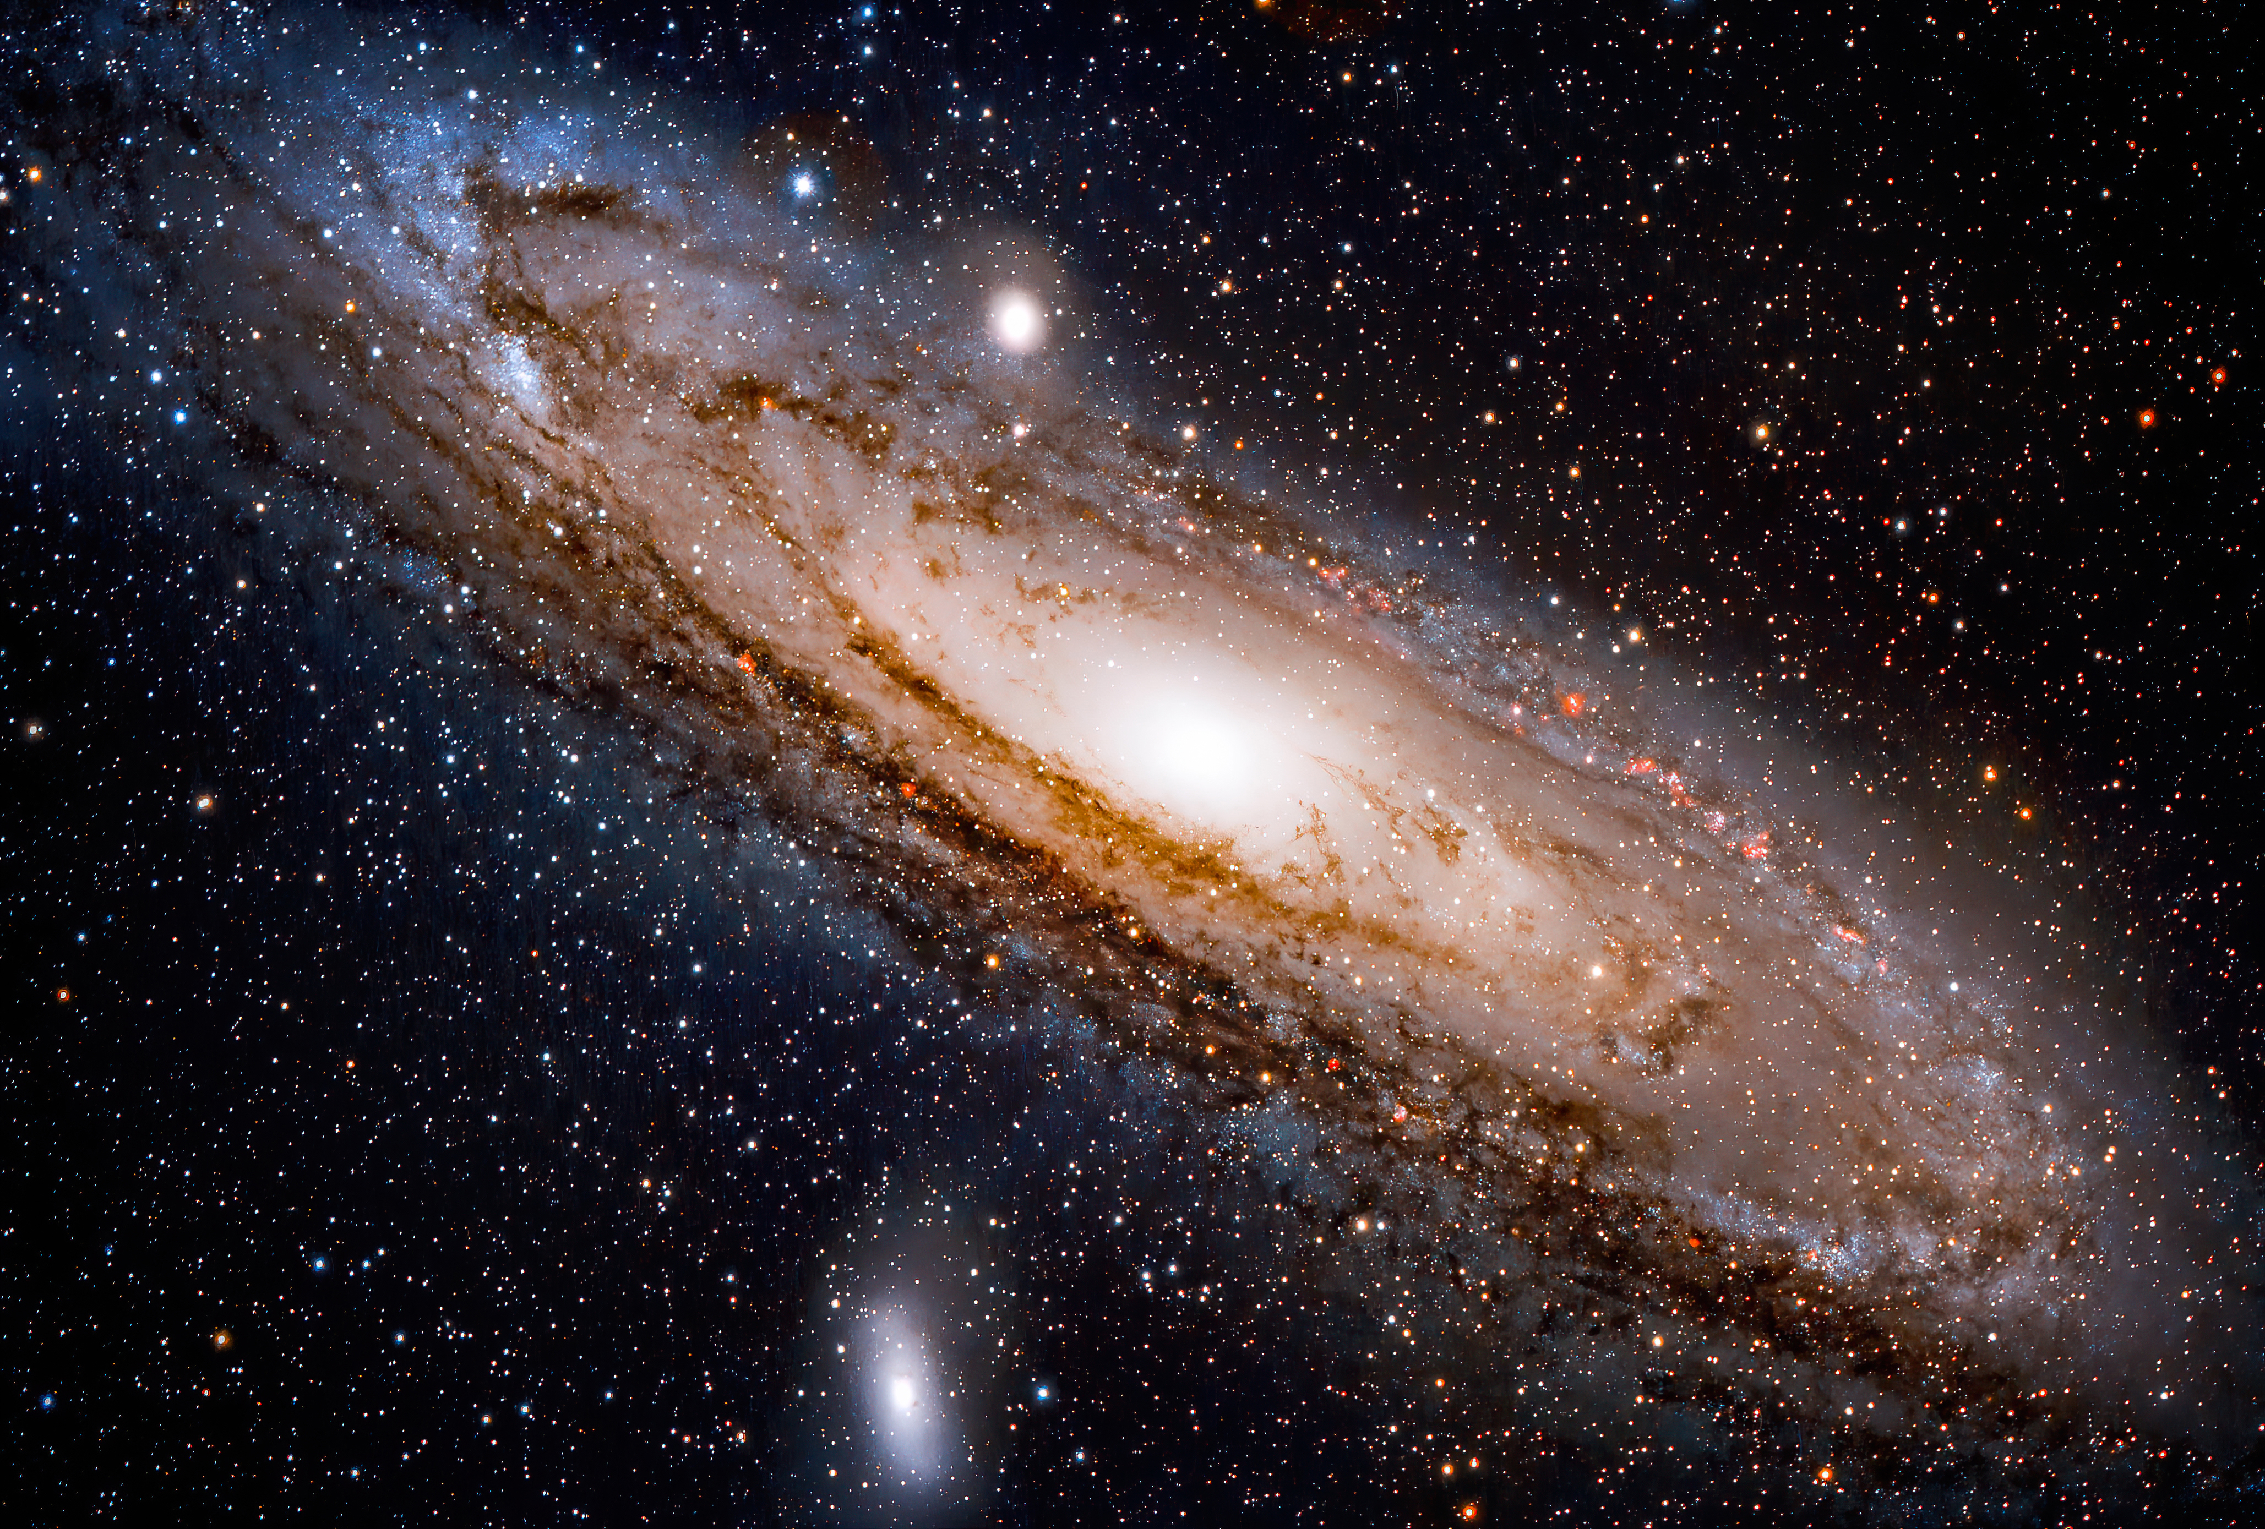
Probing the AGN Nature of Maser Galaxy Hosts
Gaudeor Rudmin
Dr. Anca Constantin
James Madison University
Summer 2023
From Dayag 2019

Slide 2
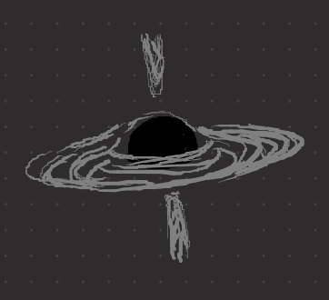
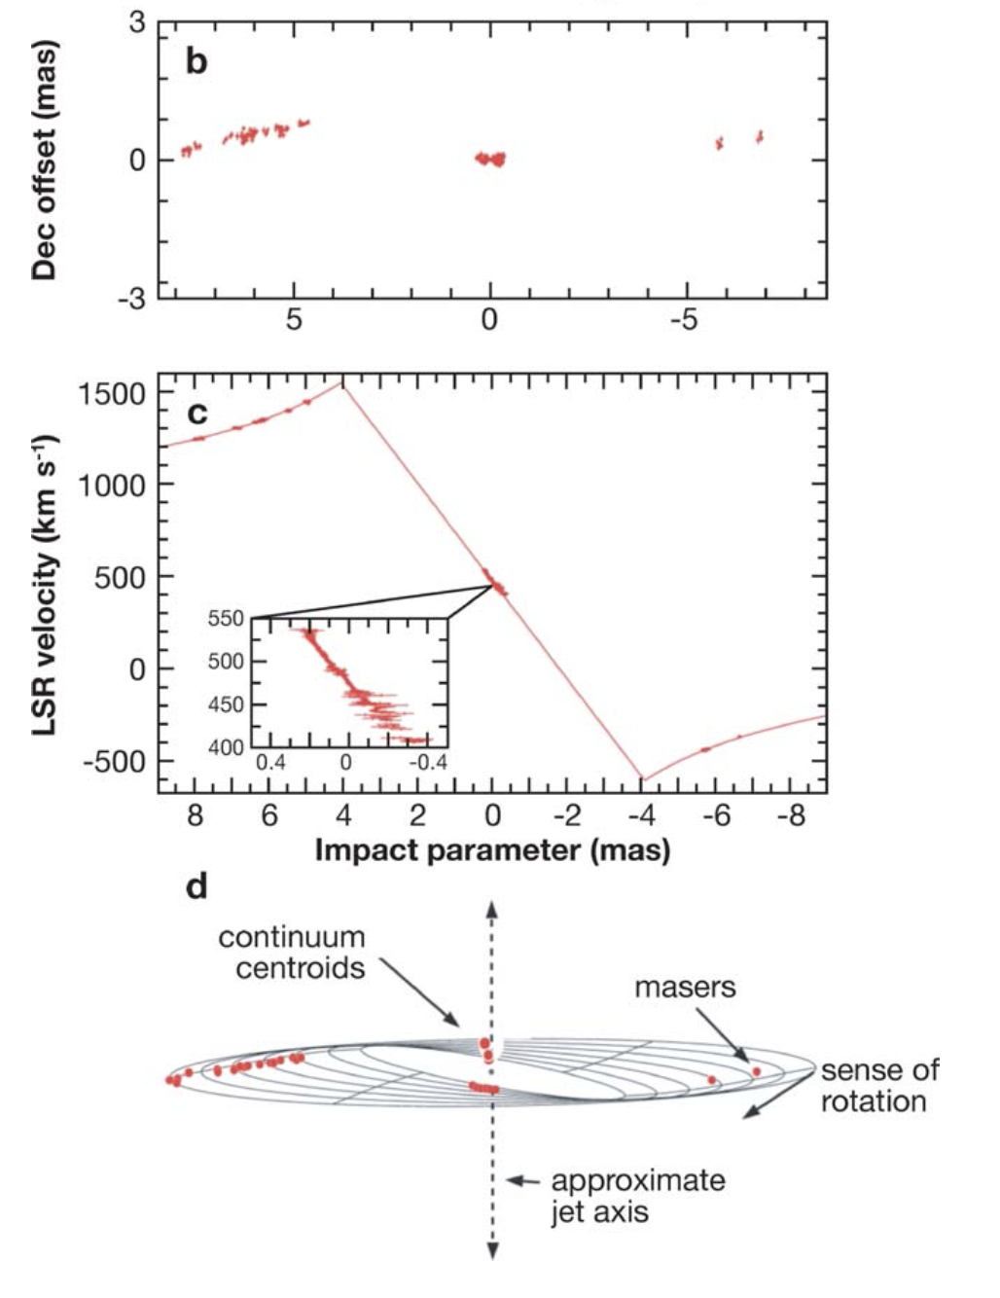

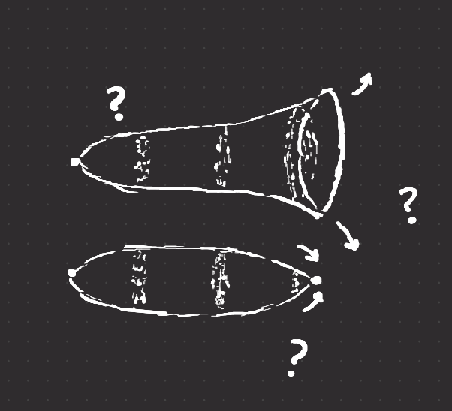
Why do we care about Maser Emission?
How massive are supermassive black holes?
How far away are other galaxies?
How do we refine cosmological models?
What is the fate of the universe?
Geometric Measurement via
Newtonian Physics
Masers are extremely rare:
< 3.6% of surveyed galaxies are masers
< 0.7% of surveyed galaxies are masers in a disk configuration (useful)

Slide 3
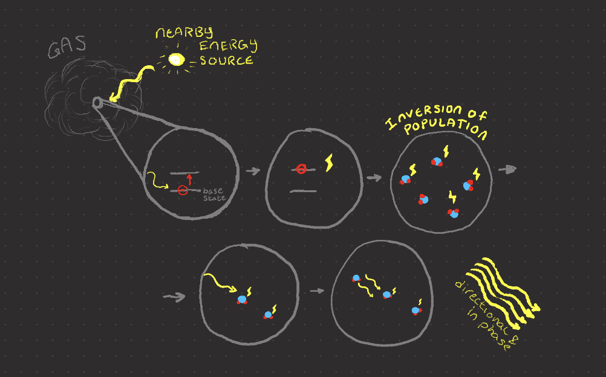
What are Masers?
Laser in
Microwave at
22 Ghz
Emitted by hot,
high density (for space)
gas with a nearby energy source
Type based on energy source

Slide 4
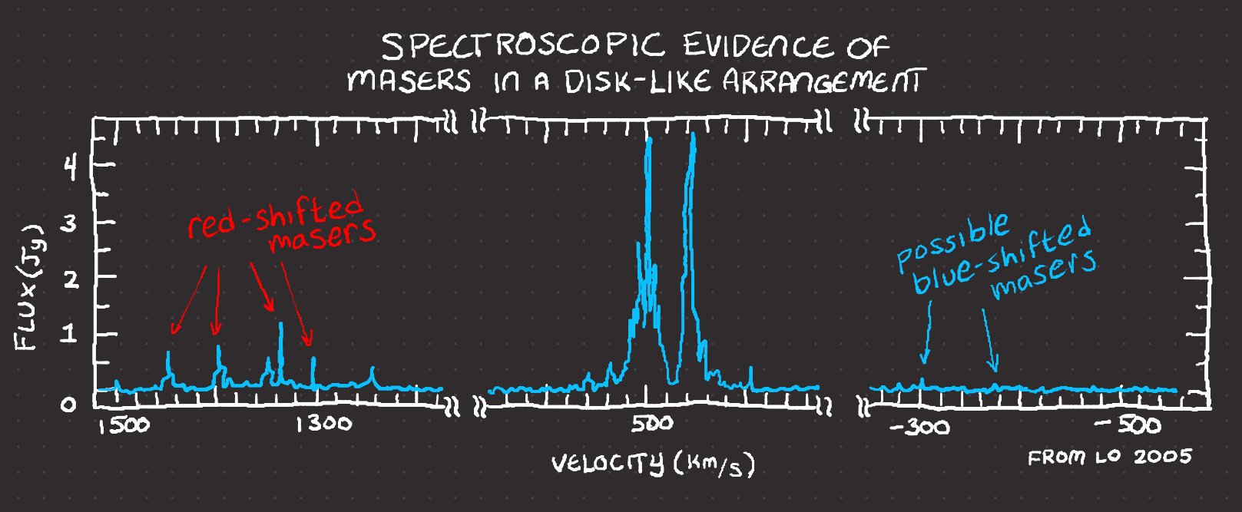




Types of Masers
Masers near Star-forming areas
MegaMasers (1 M x more luminous)
From Galaxy Centers
Maser Disks (Rare)

Slide 5
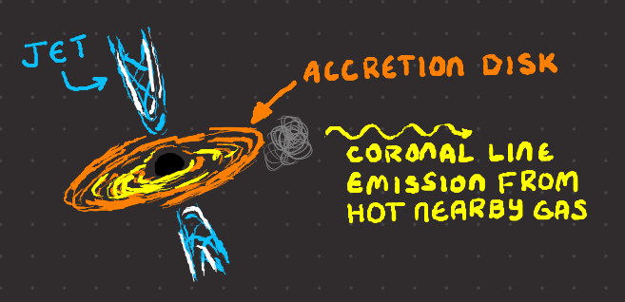
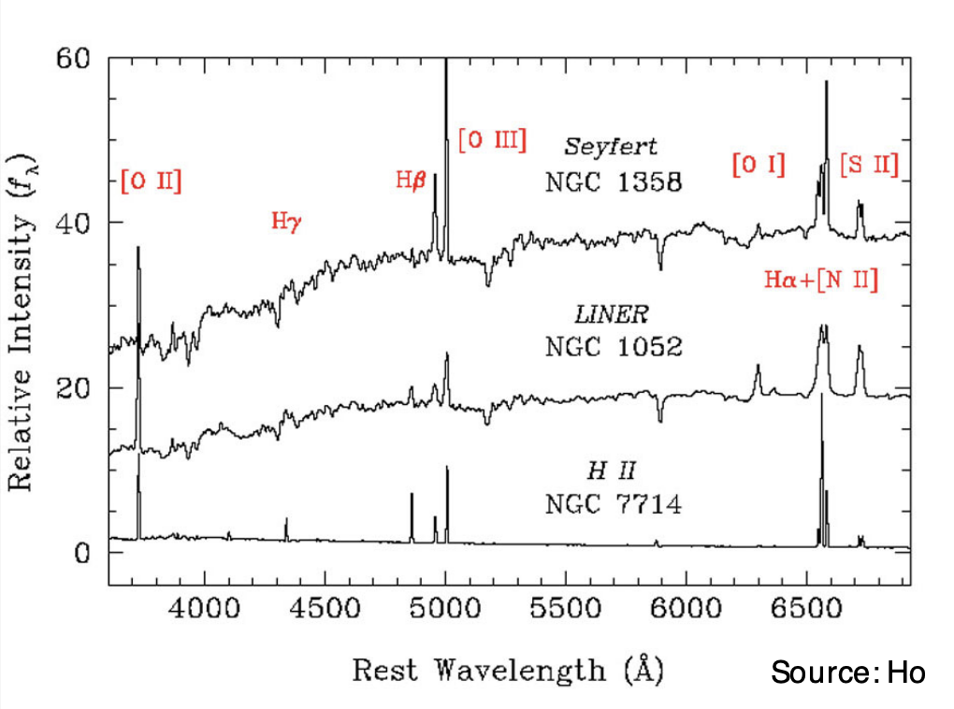
Active Galactic Nucleus (AGN)
A black hole feasting at the center of a Galaxy on an accretion disk of gas and dust.
We know more about AGN than
about masers, so finding a
connection could help us understand
megamasers’ properties.
AGN Identification
Xray | Variability (all wavelengths)
Radio (Jet) | Optical Spectroscopic Lines
Mid-Infrared | Coronal Spectroscopic Lines
From Ho 2008

Slide 6
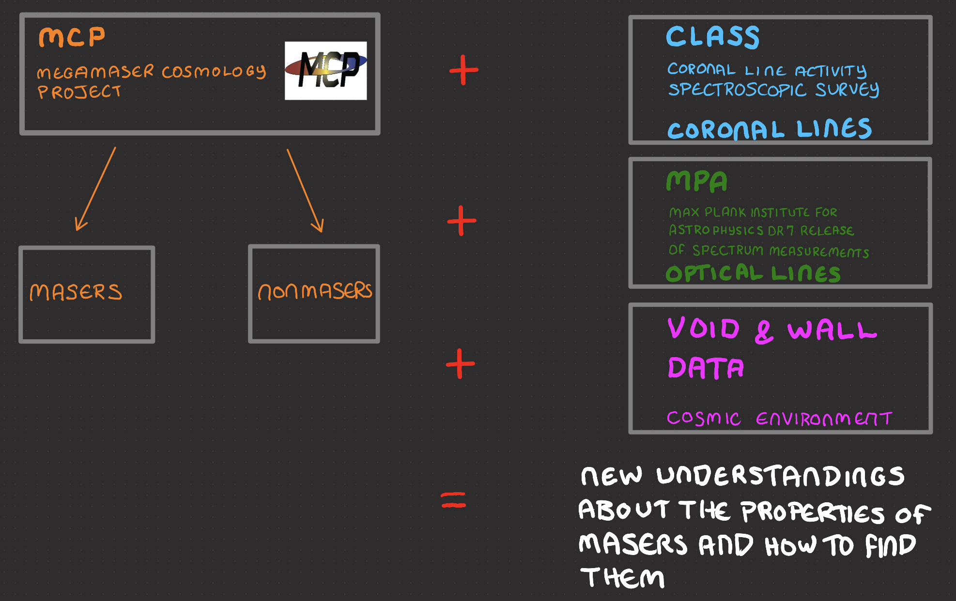
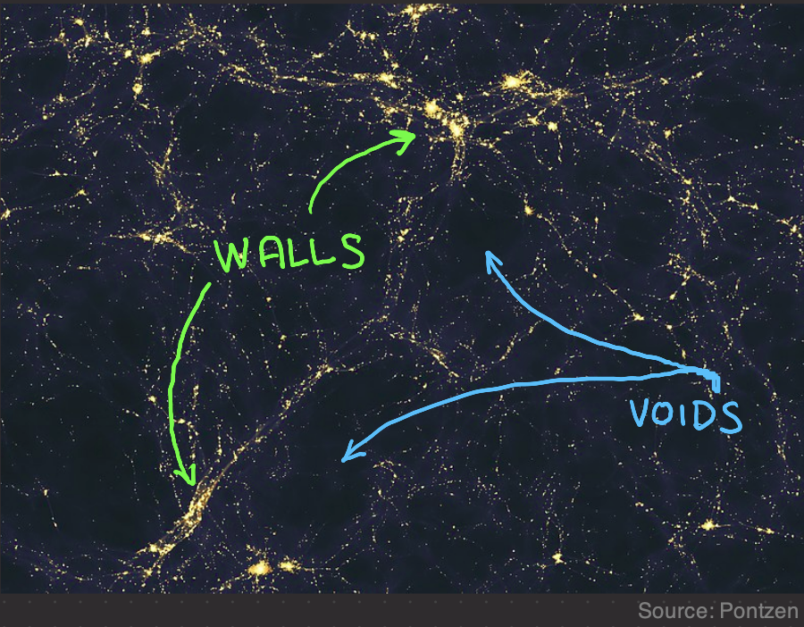
The Data
4959
180
4779
131
33

Slide 7
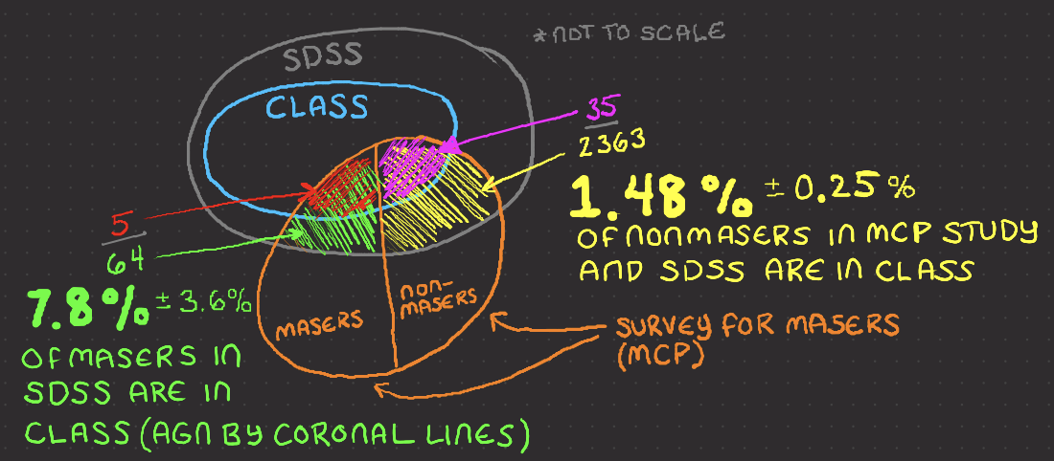
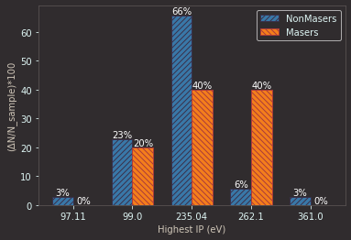
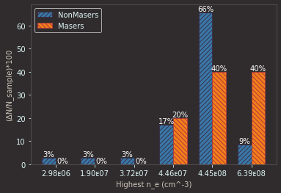
Masers VS Coronal Line AGN
A higher percentage of
Masers have coronal
Lines (so are AGN) than
non-masers.
Physical Properties
associated with
coronal Lines:
Ionization Potential (IP)
And Critical Density
(n_e)

Slide 8
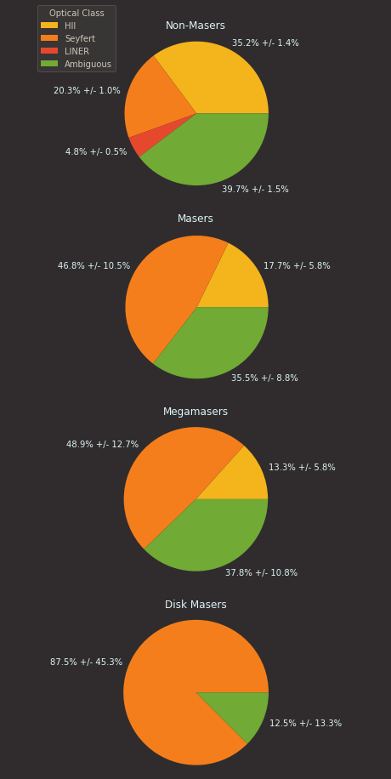
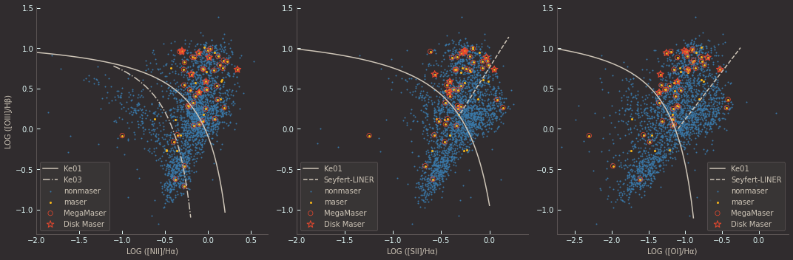
Masers VS Optical Line AGN
Masers are concentrated in the Seyfert AGN area.
Disk Masers are almost exclusively Seyfert AGNs
AGN
Seyfert AGN
Seyfert AGN
Star-Forming
Star-Forming
Star-Forming
LINER AGN
LINER AGN

Slide 9
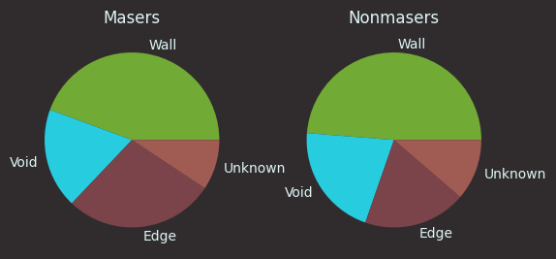
Masers VS Cosmic Environment
Location | Masers | Non-masers
Wall | 44.4% +/- 10.9% | 48.7% +/- 1.8%
Void | 18.5% +/- 6.4% | 20.9% +/- 1.1%
Edge | 27.8% +/- 8.1% | 19.0% +/- 1.0%
Unknown | 9.3% +/- 4.3% | 11.3% +/- 0.8%
Modified from Pontzen 2014

Slide 10
Conclusions
There were statistically significant differences between Masers and Nonmasers using:
Coronal Line AGN Detection
Optical Line AGN Detection
They may be useful tools in narrowing the search for usable Maser Disks
Galaxy’s location in the cosmic environment does not seem to be a useful tool.
Future Exploration
Use other AGN detection methods
More data

Slide 11
Acknowlegements
Dr. Constantin for mentoring this project
Emily McPike for help understanding AGN
Anish Aradhey for help with cosmic void and wall data
This work has been supported by JMU’s Physics and Astronomy Department and the National Science Foundation award NSF:AST #1814594.
This research has made use of the NASA/IPAC Extragalactic Database (NED), which is operated by the Jet Propulsion Laboratory, California Institute of Technology, under contract with the National Aeronautics and Space Administration, of the Sloan Digital Sky Survey
This Research has made use of the Sloan Digital Sky Survey (SDSS). Funding for the Sloan Digital Sky Survey V has been provided by the Alfred P. Sloan Foundation, the Heising-Simons Foundation, the National Science Foundation, and the Participating Institutions. SDSS acknowledges support and resources from the Center for High-Performance Computing at the University of Utah. The SDSS web site is www.sdss.org. SDSS is managed by the Astrophysical Research Consortium for the Participating Institutions of the SDSS Collaboration, including the Carnegie Institution for Science, Chilean National Time Allocation Committee (CNTAC) ratified researchers, the Gotham Participation Group, Harvard University, Heidelberg University, The Johns Hopkins University, L’Ecole polytechnique fédérale de Lausanne (EPFL), Leibniz-Institut für Astrophysik Potsdam (AIP), Max-Planck-Institut für Astronomie (MPIA Heidelberg), Max-Planck-Institut für Extraterrestrische Physik (MPE), Nanjing University, National Astronomical Observatories of China (NAOC), New Mexico State University, The Ohio State University, Pennsylvania State University, Smithsonian Astrophysical Observatory, Space Telescope Science Institute (STScI), the Stellar Astrophysics Participation Group, Universidad Nacional Autónoma de México, University of Arizona, University of Colorado Boulder, University of Illinois at Urbana-Champaign, University of Toronto, University of Utah, University of Virginia, and Yale University.

Slide 12
References
Braatz, J., Condon, J., & Constantin, A, et al, (2020, June 15). The Megamaser Cosmology Project (MCP). MegamaserCosmologyProject. NRAO public wiki.
https://safe.nrao.edu/wiki/bin/view/Main/MegamaserCosmologyProject
Dayag, D. (2019). Andromeda Galaxy 560mm FL. Wikimedia Commons. Retrieved July 25, 2023, from
https://commons.wikimedia.org/wiki/File:Andromeda_Galaxy_560mm_FL.jpg.
Douglass, K. A., Veyrat, D., & BenZvi, S. (2023). Updated void catalogs of the SDSS DR7 main sample. The Astrophysical Journal.
Supplement Series, 265(1), 7. https://doi.org/10.3847/1538-4365/acabcf
Ho, L. C. (2008). Nuclear Activity in Nearby Galaxies. Annual Review of Astronomy and Astrophysics, 46(1), 475–539.
https://doi.org/10.1146/annurev.astro.45.051806.110546
Keel, B. (2002, November). Optical Spectra of Various Kinds of Active Galactic Nuclei. Active Galaxies and Quasars – Spectrum
Comparison. https://pages.astronomy.ua.edu/keel/agn/spectra.html
Kollmeier, J. A., Zasowski, G., Rix, H. W., Johns, M., Anderson, S. F., Drory, N., ... & van Saders, J. L. (2017). SDSS-V: pioneering panoptic
spectroscopy. arXiv preprint arXiv:1711.03234.
Lo, K. Y. (2005). Mega-masers and Galaxies. Annual Review of Astronomy and Astrophysics, 43(1), 625–676.
https://doi.org/10.1146/annurev.astro.41.011802.094927
The Max Planck Institute for Astrophysics. (n.d.). The MPA-JHU DR7 release of spectrum measurements. The MPA-JHU DR7 release of Spectrum Measurements.
https://wwwmpa.mpa-garching.mpg.de/SDSS/DR7/
Pontzen, A., &amp; Governato, F. (2014). Large-scale Structure of Light Distribution in the Universe. Wikimedia Commons. Retrieved
July 25, 2023, from https://commons.wikimedia.org/wiki/File:Large-scale_structure_of_light_distribution_in_the_universe.jpg.
Reefe, M., Satyapal, S., Sexton, R. O., Doan, S. M., Secrest, N. J., &amp; Cann, J. M. (2022). Class: Coronal line activity spectroscopic survey. The
Astrophysical Journal, 936(2), 140. https://doi.org/10.3847/1538-4357/ac8981

